Slide 1
Visualizing Multimodal Data
LOT Winter School 2024, Šárka Kadavá

Slide 2
Content of the workshop
01
02
03
04
Why should we care?
What is possible?
Plots for multimodal data
Dashboards

Slide 3
01
Why should we care?

Slide 4

Imagine…
You spend hours and hours on designing an experiment, piloting the setup, recording the data…
You are done, and you start to process the data – extract features, explore their relationships, building statistical models, etc.

Slide 5
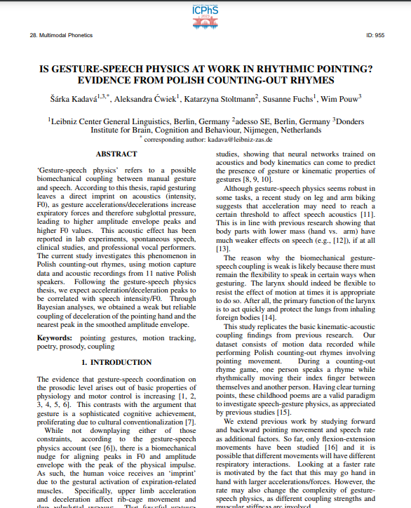
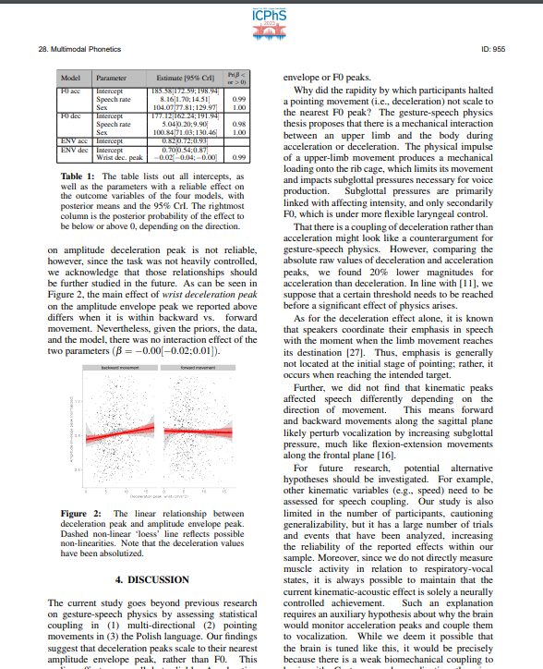
And when you are finaly done…

Slide 6

And when you are finaly done…
…this is what remains from my beautiful data

Slide 7
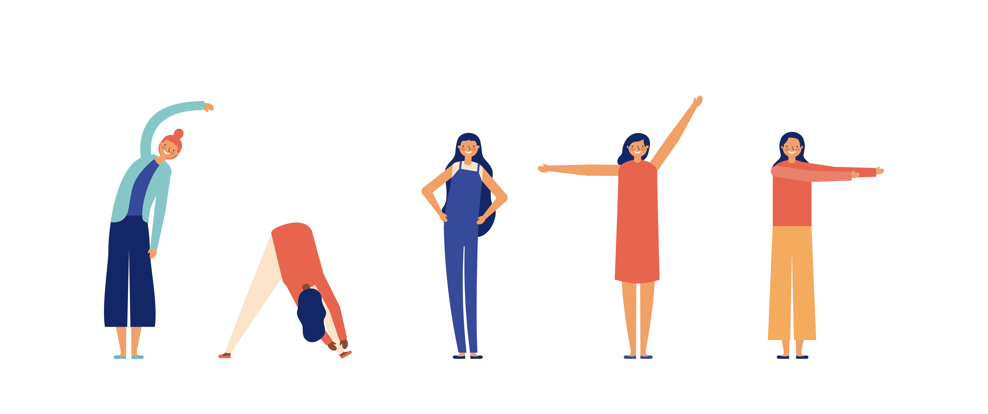
Where are the videos that took so much time to collect? Where is the movement that we claim to be so important?

Slide 8
02
What is possible?

Slide 9

Imagine…
You have an experiment in which people do some movements and sounds. Now you are writing a paper…

Slide 10
How do you make use of these data?

Slide 11
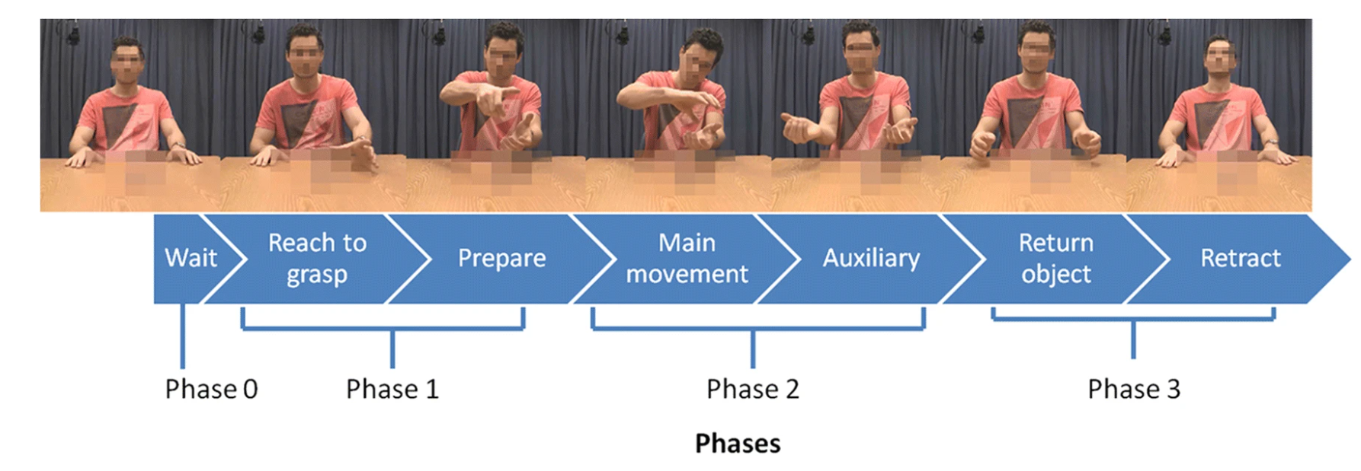
Example (Trujillo et al., 2020)

Slide 12
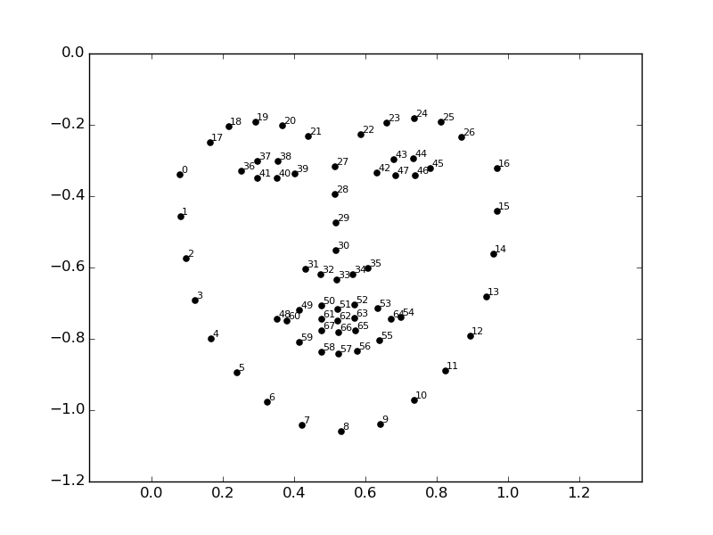
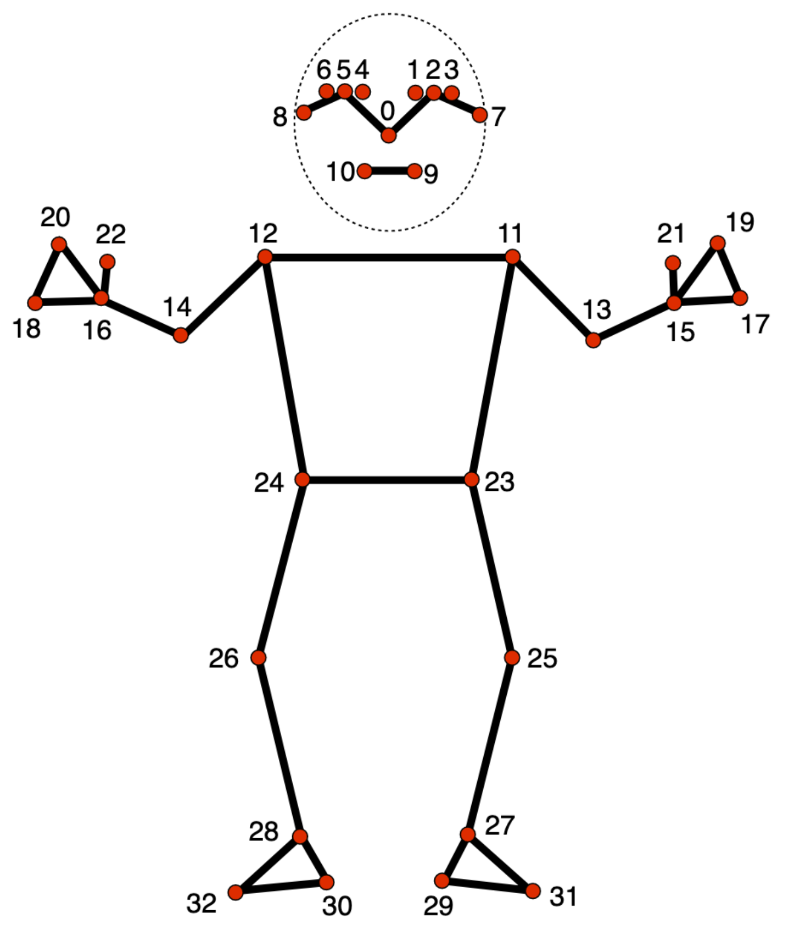
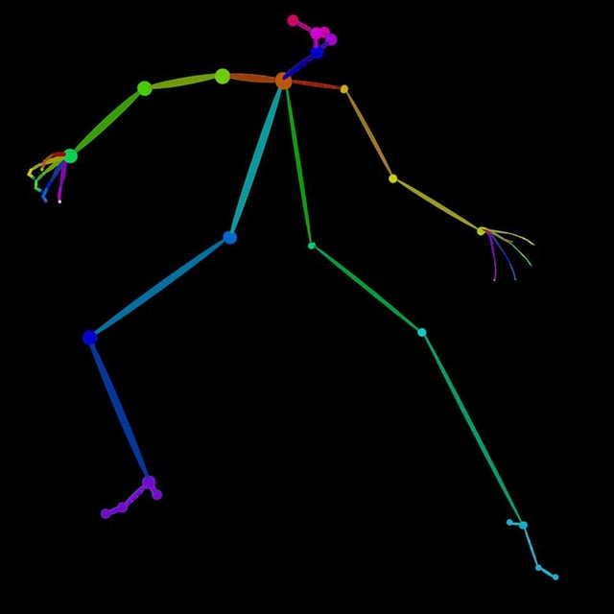
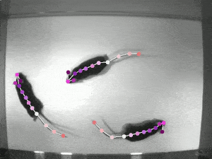
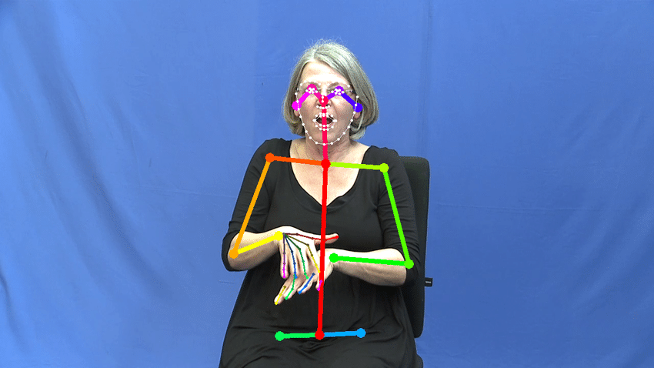
Examples
MediaPipe
OpenFace
OpenPose
DeepLabCut
Schulder & Hanke, 2020

Slide 13
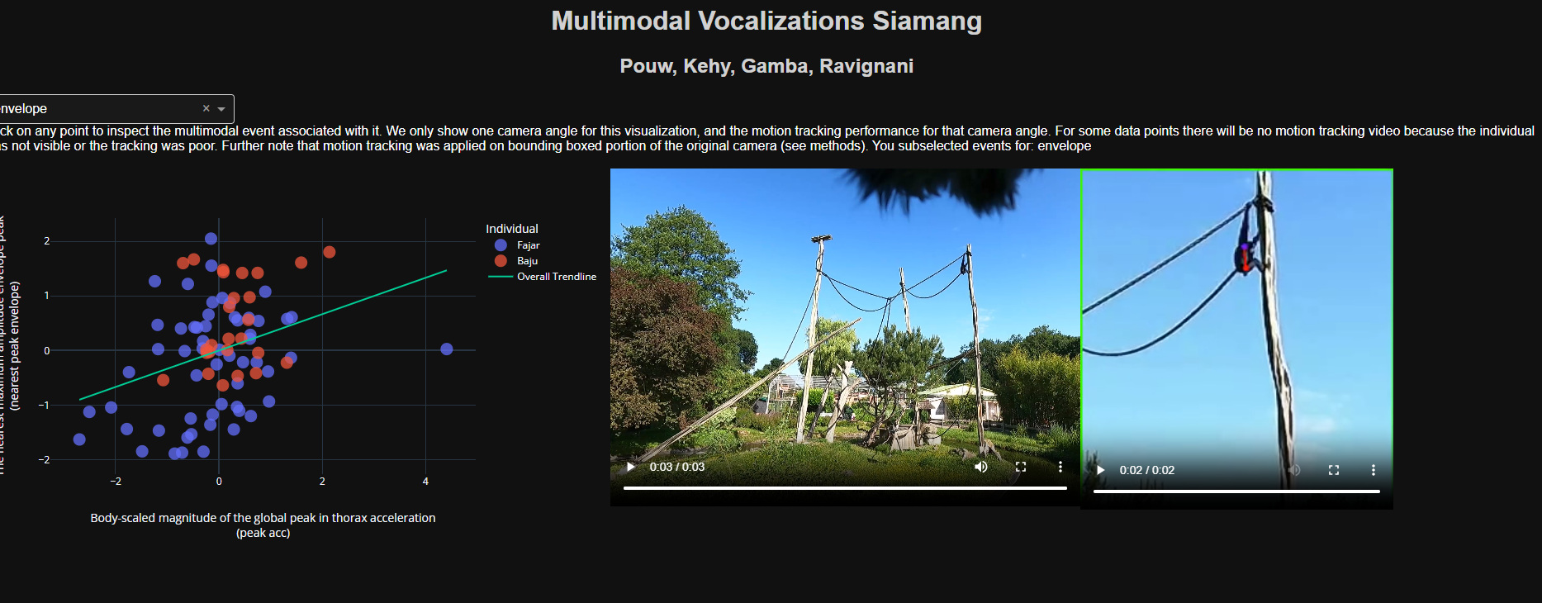
Example (Pouw et al., 2023)
https://tsg-131-174-75-200.hosting.ru.nl/siamang/

Slide 14
03
Plots for multimodal data

Slide 15
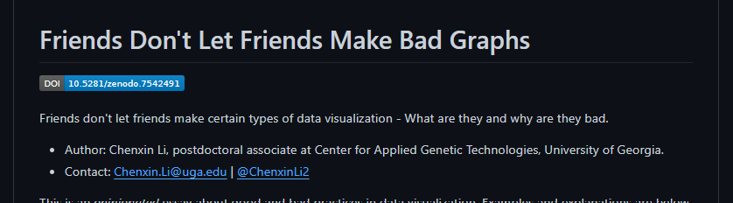
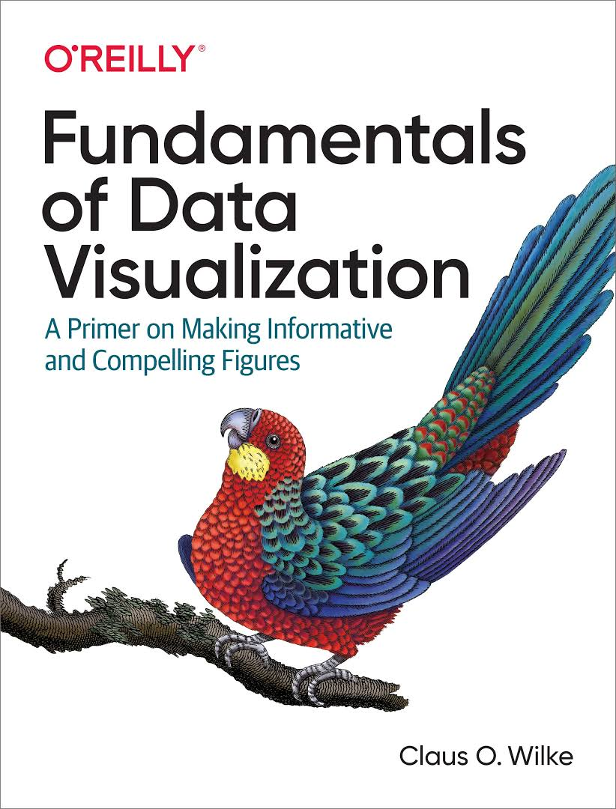
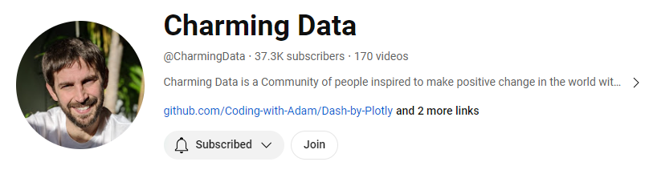
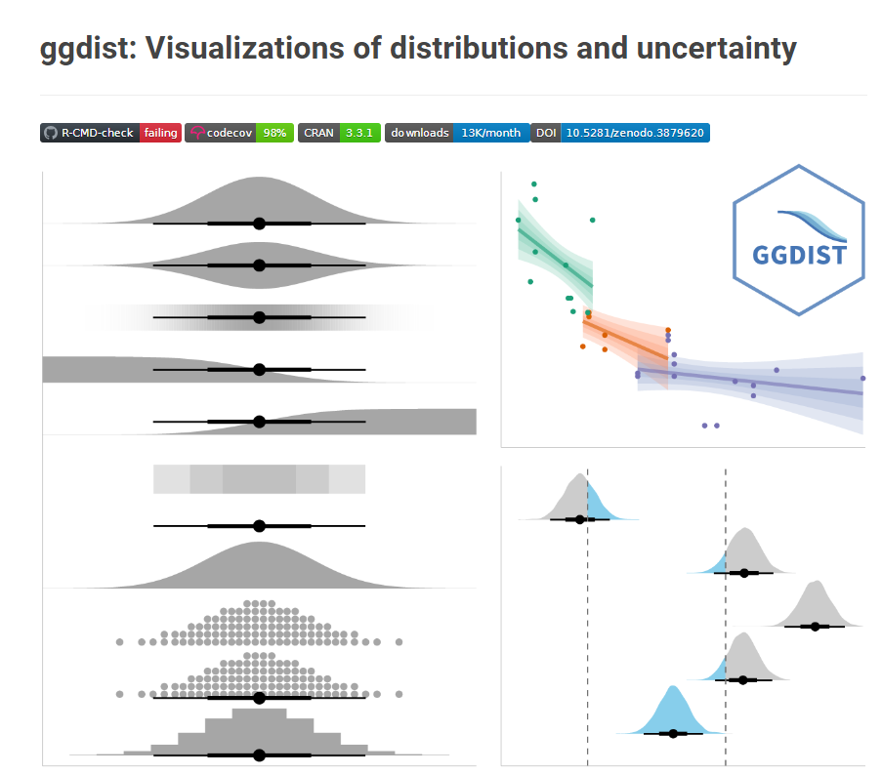
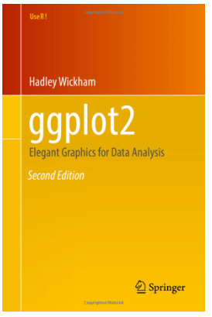

https://dash.plotly.com/
Notes:
Also watch codes of articles where you like some plot ☺

Slide 16
Multimodal essentials
Our data
change in time
consists of various signals
that have variety of characteristics

Slide 17
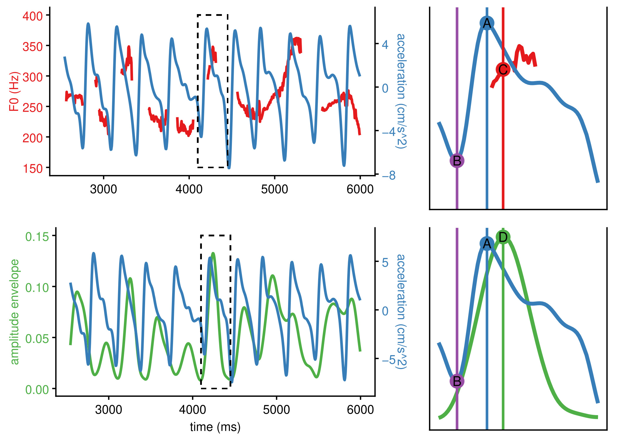
Example (Kadavá et al., 2023)

Slide 18
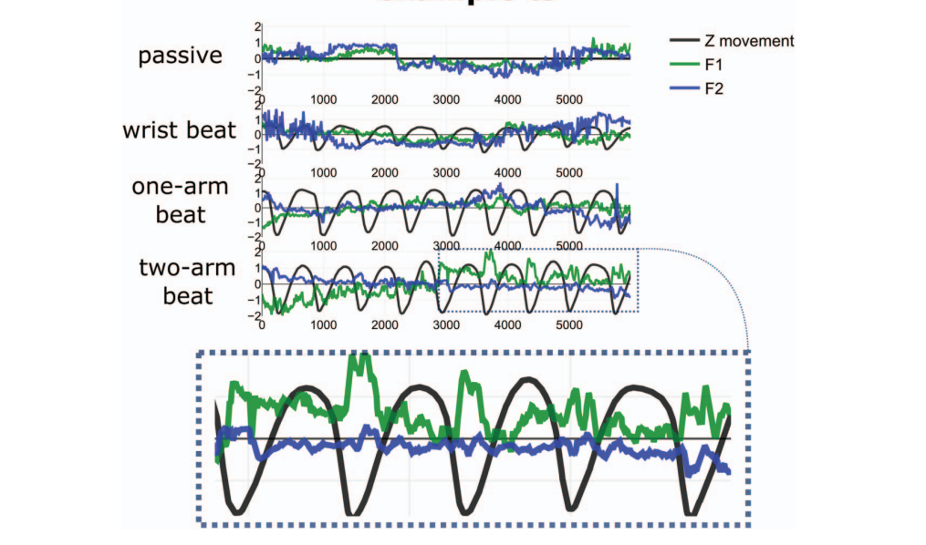
Example (Pouw et al., 2020)

Slide 19
04
Dashboards

Slide 20
Dashboards
App that allows user to display various types of (visual) data
→ it provides direct access to our (visual) data
→ it has a default interface, but also user freedom

Slide 21
Key components
Data
Html/dash components
Default interface
Update

Slide 22

Let’s get to work

Slide 23
Last but not least
You need to upload the app to server to be able to use it online

Slide 24
Last but not least
Be aware of privacy!

Slide 25

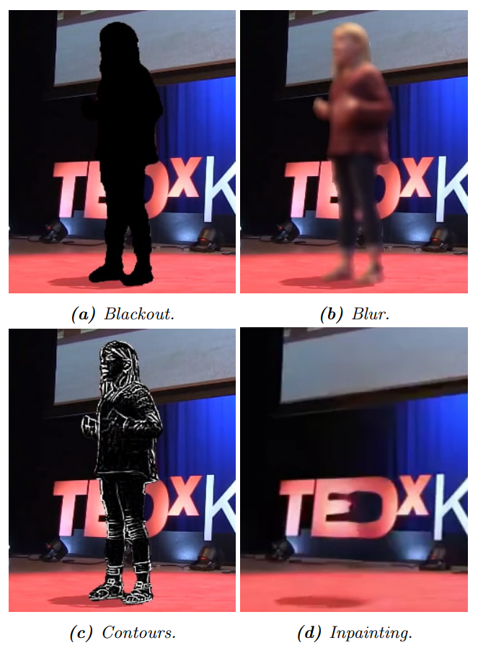
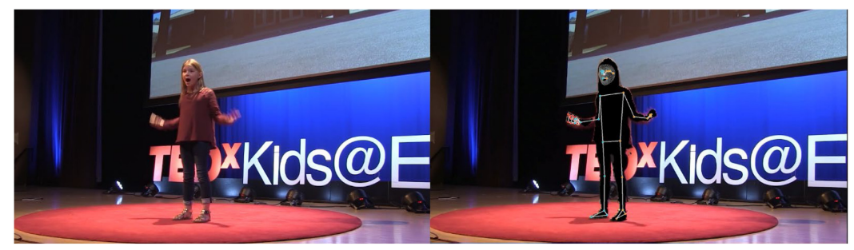
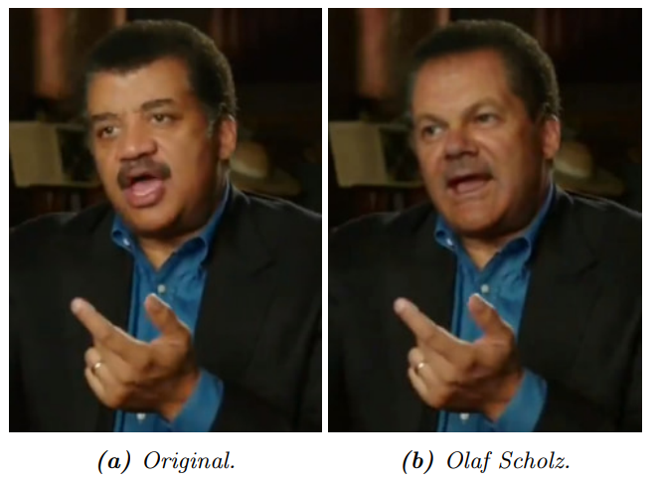
Masking tools
MaskAnyone
Masked-Piper (Owoyele et al., 2022)

Slide 26

Thank you
kadava@leibniz-zas.de
sarkadava

Slide 27
References
Kadavá Š., Ćwiek A., Stoltmann K., Fuchs S., Pouw W. (2023). Is gesture-speech physics at work in rhythmic pointing? Evidence from Polish counting-out rhymes. In: R. Skarnitzl & J. Volín (Eds.), Proceedings of the 20th International Congress of Phonetic Sciences. Guarant International.
Owoyele, B., Trujillo, J., De Melo, G., & Pouw, W. (2022). Masked-Piper: Masking personal identities in visual recordings while preserving multimodal information. SoftwareX, 20, 101236.
Pouw, W., Harrison, S. J., & Dixon, J. A. (2020). Gesture–speech physics: The biomechanical basis for the emergence of gesture–speech synchrony. Journal of Experimental Psychology: General, 149(2), 391.
Pouw, W., Kehy, M., Gamba, M., & Ravignani, A. (2023). Cross-modal constraints in multimodal vocalizations in Siamang (Symphalangus syndactylus).
Schulder, M., & Hanke, T. (2019). OpenPose in the Public DGS Corpus. Hamburg: University of Hamburg.
Trujillo, J. P., Simanova, I., Bekkering, H., & Özyürek, A. (2020). The communicative advantage: How kinematic signaling supports semantic comprehension. Psychological research, 84, 1897-1911.

